Slide 1

CS 533 INTRO TO DATA SCIENCE
Michael Ekstrand

Slide 2
CLUSTERING

Slide 3
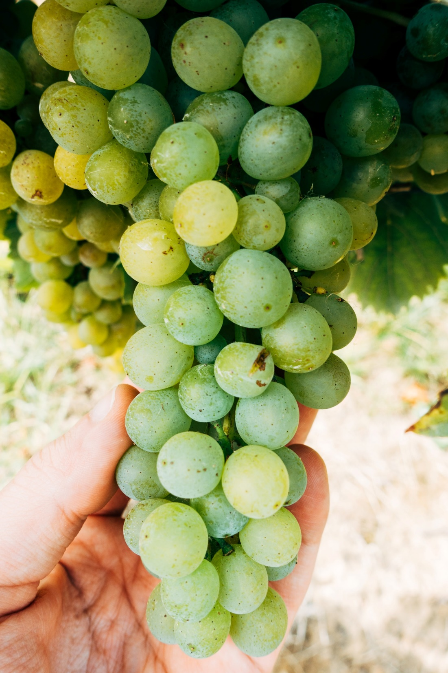
Learning Outcomes
Understand the idea of ‘clustering’
Interpret the results of clustering with k-means
Photo by Markus Winkler on Unsplash

Slide 4
Grouping Things Together
What if we want to find groups in our data points?
We don’t know the groups (or we would classify)
Find them from the data
This is clustering

Slide 5
Membership Kinds
Mixed-membership: point can be in more than one cluster
Matrix factorization can be a kind of clustering
Single-membership: point is in precisely one cluster

Slide 6
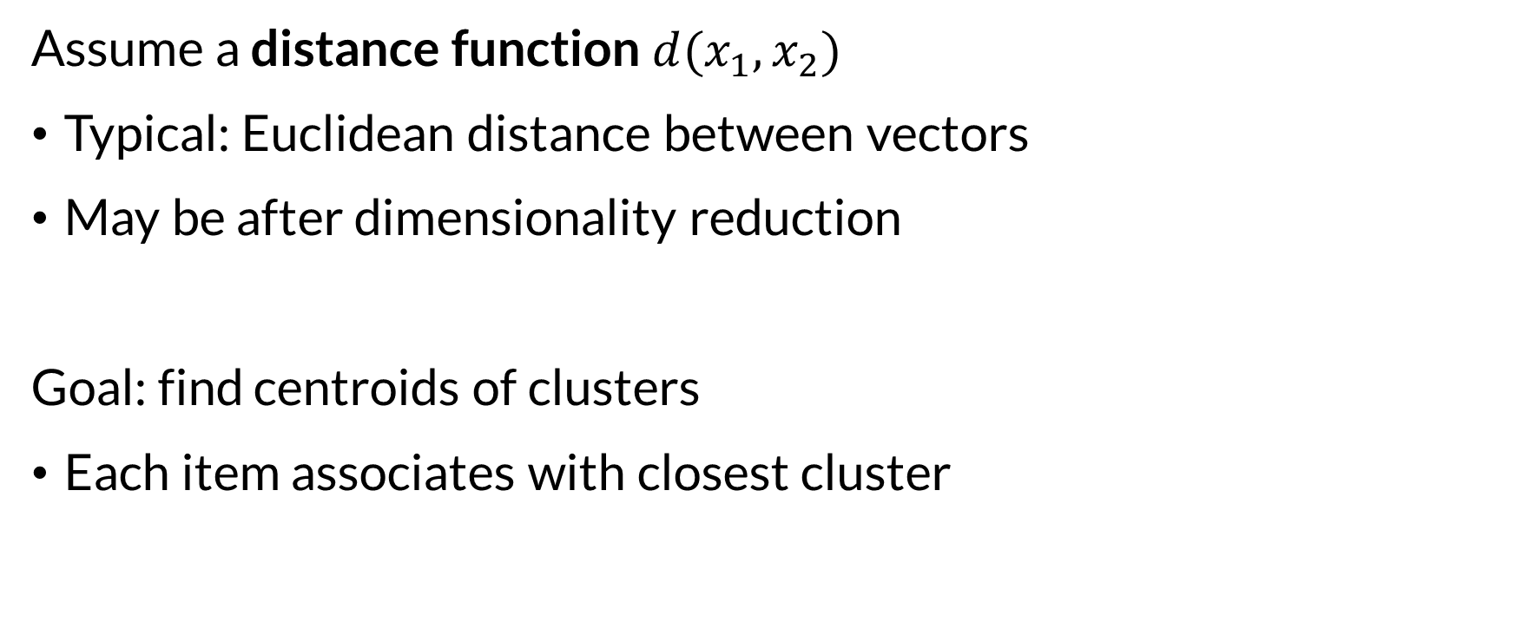
Centroid-Based Clustering
Assume a distance function $d(x_{1},x_{2})$
Typical: Euclidean distance between vectors
May be after dimensionality reduction
Goal: find centroids of clusters
Each item associates with closest cluster

Slide 7
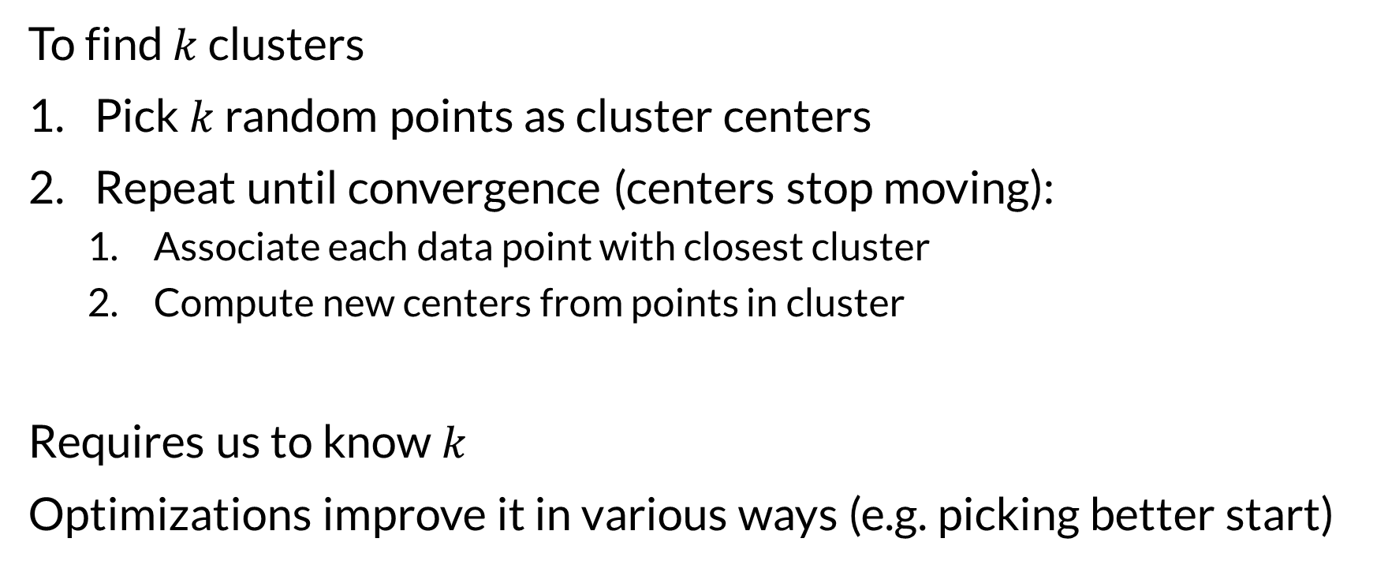
K-Means Algorithm
To find $k$ clusters
Pick $k$ random points as cluster centers
Repeat until convergence (centers stop moving):
Associate each data point with closest cluster
Compute new centers from points in cluster
Requires us to know $k$
Optimizations improve it in various ways (e.g. picking better start)

Slide 8
Clustering in SKlearn
KMeans class
fit(X) learns cluster centers (can take y but will ignore)
predict(X) maps data points to cluster numbers
cluster_centers_ has cluster centers (in input space)
Other clustering algorithms have similar interface.

Slide 9
Evaluating Clusters
Look at them
Seriously. Look at them.
If you have labels, compare
Useful for understanding behavior
Quality scores
E.g. silhouette compares inter- and intra-cluster distances
Can be used to compare clusterings, no absolute quality values

Slide 10

Wrapping Up
Clustering allows us to identify groups of items from the data.
May or may not make sense.
Cluster quality depends on features, metric, cluster count, and more.
Photo by Igor Milicevic on Unsplash

